Slide 1

The Programmable Trust
Understanding Blockchain
Instant value transfer between strangers, without intermediaries.
Trust guaranteed by math and networks, not by institutions.
The most important technological shift of our generation.
05-12-2025 / Computer Networks / Wrocław University of Science and Technology
Presenter: Álvaro Puebla Ruisánchez - Group 5
Notes:
Presenter Notes: "Imagine a world where trust doesn't depend on a bank or government, but on mathematics and code. This is the promise of blockchain technology.
Over the past few years, we've seen an explosion of cryptocurrencies, NFTs, and digital assets.
But beneath all the hype and speculation lies a fascinating technology that is fundamentally changing how we establish trust in digital systems.
My name is Álvaro Puebla and today, I want to take you on a journey to understand what blockchain really is, how it works, and why it matters."

Slide 2
Your Roadmap to Understand Blockchain
Seven key concepts to master:
1
Centralization vs. Decentralization
2
The Blockchain Architecture
HASH: 0000000025476b2a…
HASH: 000000005669ffa3…
HASH: 000000003bcfff29…
3
Trust Without Intermediaries
Transaction 1
Transaction 1
Transaction 1
Transaction 2
Transaction 2
Transaction 2
4
Proof of Work and Mining
Transaction 3
Transaction 3
Transaction 3
5
15
43
23
Keys Public and Private
HASH: 000000005669ffa3…
HASH: 000000003bcfff29…
HASH: 0000000077ab26f5…
6
Real World Applications
7
Challenges
Notes:
Presenter Notes: "We have a lot of ground to cover, so let me give you a roadmap.
First, we'll understand why decentralization is important and what problems it solves.
Then, we'll dive into the technical architecture, how blocks are created, linked together, and secured.
Next, we'll explore the ingenious mechanisms that allow strangers to agree on a single truth without a central authority.
We'll see how mining and Proof of Work make the network secure.
Then, we'll look into the inner workings of cryptography.
Finally, we'll explore real-world applications and their challenges."

Slide 3


The Fragility of Centralized Architecture
Single Point of Failure: If the central server fails, the entire network stops
Control Concentrated: All power and decision-making in one entity
Trust Required: Must trust the central authority completely
Limited Transparency: Users cannot verify what happens behind the scenes
Notes:
Presenter Notes: "Let's start with a problem we all know too well. Remember when CloudFlare went down? Or when Amazon had an outage?
This happens because these services rely on centralized architecture.
All users connect to central servers controlled by a single company. If those servers fail, the entire network fails. But the problem goes deeper than just reliability.
In a centralized system, all power and control are concentrated in one entity. That entity decides the rules, manages the data, and can manipulate transactions.
We must trust them completely. This is fine for some applications, but for financial systems, voting, or identity management, this concentration of power is problematic.
What if there was a better way?"

Slide 4
Peer-to-Peer (P2P) Networks: A Better Way
Every Node is Equal: No central server, all participants are peers
Distributed Storage: Each node stores data and processes transactions
Resilience: If one node fails, the network continues operating
The Challenge: How do we reach consensus without a central authority?
Notes:
Presenter Notes: "The alternative is a peer-to-peer, or P2P, network. In a P2P network, every computer is equal.
There's no central server. Each node stores data, processes transactions, and communicates directly with other nodes.
XXXX
If one node fails, the network keeps working.
You've probably used P2P technology before, BitTorrent works this way.
When you download a file from BitTorrent, you're not downloading from a central server.
Instead, you're downloading pieces from other computers in the network, and simultaneously, others are downloading pieces from you.
This is resilient and censorship-resistant.
But here's the challenge: how do we coordinate? How do we agree on what's true when there's no central authority to decide? This is where blockchain comes in."

Slide 5
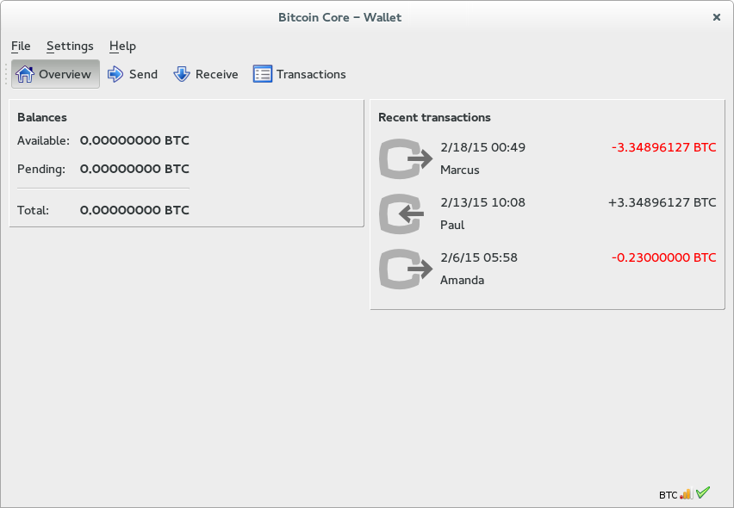
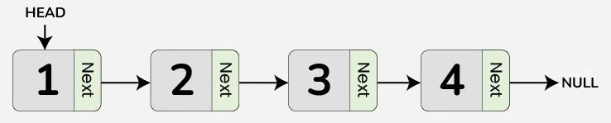
Blockchain: A Distributed, Immutable Ledger
A distributed database replicated across thousands of computers, where data can only be added, never modified or deleted.
Distributed: Replicated across thousands of computers, not controlled by a single entity
Append-Only: Data can only be added; existing entries cannot be modified or deleted
Transparent: All transactions are visible and verifiable by all participants
Immutable: Once recorded, data is permanent and cannot be erased without notice
Each block contains transactions and references the previous block's hash, creating an unbreakable chain
Notes:
Presenter Notes: "Blockchain is essentially a distributed, append-only ledger.
Think of it as a shared notebook that is replicated across thousands of computers. When a new transaction occurs, it's added to this ledger.
The key feature is that it's append-only, you can only add new entries, you cannot modify or delete existing ones.
This immutability is crucial. Once something is recorded, it's permanent. And because the ledger is distributed, everyone has a copy. Everyone can verify the history.
This creates transparency without requiring a central authority.
For a digital currency like Bitcoin, the currency itself is not a file or a coin. It's the record of all transactions.
If I have 10 bitcoins and I send 2 to someone else, that transaction is recorded in the ledger. Everyone can verify that I had those bitcoins and that I transferred them."

Slide 6
Solving the Time Synchronization Problem
How blocks create temporal order in distributed networks
1
2
3
The Problem
The Solution
The Result
Transactions arrive at different times across the network. Clock synchronization is impossible.
→
Group transactions into blocks. All transactions in a block are considered simultaneous.
→
Blocks create a chronological sequence. The blockchain orders events reliably.
Block 1
B1
B2
B3
B4
B5
T1
T3
T4
T9
T1
T3
T4
T9
T7
T2
T6
T8
T7
T2
T6
T8
T5
T5
Notes:
Presenter Notes: "Here's a problem that's often overlooked: in a distributed network, how do we agree on the order of events?
Transactions are happening simultaneously across the network. They arrive at different nodes at different times.
You might think we could synchronize clocks, but that's impossible in a distributed system.
Each computer has its own clock, and synchronizing them requires communication, which also takes time.
The solution is the block. Instead of trying to order individual transactions, we group them into blocks.
A block is a batch of transactions that occurred during a specific time window. All transactions within a block are considered to have occurred at roughly the same time.
This solves the ordering problem. The blockchain then orders the blocks, creating a chronological sequence of events."

Slide 7
Anatomy of a Block: The Building Blocks of Trust
1
Previous Block's Hash
Block Header
The cryptographic link to the previous block. This creates the chain. If any data in the previous block changes, its hash changes, breaking the link.
0x00000001
Version:
1
Difficulty(nBits):
00000000839a8e6886ab5951d76f4114
75428afc90947ee320161bbf18eb6048
Merkle Root
Previous Hash:
2
A single hash that summarizes all transactions in this block. It's like a fingerprint of all transactions, enabling efficient verification.
9b0fc92260312ce44e74ef369f5c66bbb85848f2eddd5a7a1cde251e54ccfdd5
Merkle Root:
‎2009-01-09 03:55:44
Timestamp:
Timestamp
3
Records when the block was created, providing chronological order to the ledger.
‎0x61bdd208
Nonce:
Block Body
Nonce
Carlos -> Elon Musk: 2 BTC
4
Transaction 1:
A number used in mining. Miners change this to find a hash that meets the difficulty target.
Álvaro -> Pedro: 50 BTC
Transaction 2:
Satoshi -> Nakamoto: 1000 BTC
Transaction 3:
XXXXX -> XXXXXXXXX: XXX BTC
Block Identity
Transaction X:
5
The hash of the header. Change any single bit of data, and the entire hash changes, making tampering instantly detectable.
Block Identity
000000006a625f06636b8bb6ac7b960a8d03705d1ace08b1a19da3fdcc99ddbd
Block Hash:
Notes:
Presenter Note:
"A block is more than just a batch of transactions, it has a header and a body. The body holds the list of transactions; the header contains the previous block's hash, a timestamp, a difficulty target, a nonce, and the Merkle root (a single hash summarizing all transactions). The Merkle tree lets any node prove that a particular transaction is included without downloading every transaction. The previous-block hash links blocks together so any change in an earlier block invalidates all later blocks. Together, grouping transactions into blocks and linking headers solves the ordering problem and creates an auditable, append-only history."

Slide 8

Cryptographic Hashing: The Foundation of Security
Key Properties of Hashing
Deterministic: Same input always produces same output. Hash the same data twice, get identical results.
Avalanche Effect: Tiny change in input produces completely different output. Change one bit, and the entire hash changes.
One-Way Function: Cannot reverse the hash to get the original input. You can only verify by hashing again.
Collision-Resistant: Virtually impossible to find two different inputs that produce the same hash.
Practical Example SHA-256 bits:
Alvaro Puebla is a student.
8B 0B 69 58 F7 BF 39 C5 47 38 B3 61
19 EF F2 67 F7 3D A0 6F 9D C6 E8 26
32 90 03 B9 63 EB 70 F8
→
SHA-256
→
Alvaro Puebla is a student
B6 A8 B3 78 EB 57 D5 5A 34 66 B6 E2
E6 FE 1B 5B 52 FB 65 40 88 8C 36 68
49 D5 EA 99 B5 BD 79 64
→
SHA-256
→
Notes:
Presenter Notes: "To understand how blockchain is secure, we need to understand cryptographic hashing.
A hash function takes any input (a file, a number, a block of data) and converts it into a fixed-size output.
Bitcoin uses SHA-256, which produces a 256-bit hash.
Here are the key properties.
First, it's deterministic: if you hash the same input twice, you get the same output.
Second, it has the avalanche effect: if you change even a single bit of the input, the output changes completely. This is crucial for security.
Third, it's one-way: you cannot reverse the hash to get the original input.
Fourth, it's collision-resistant: it's virtually impossible to find two different inputs that produce the same hash.
These properties make hashing perfect for creating tamper-evident records."

Slide 9



The Sybil Attack: Why Consensus is Hard
The fundamental challenge of voting without a central authority
1
2
3
The Attack
Creating Fake Identities
The Problem
The Real Solution
How do we vote?
In a decentralized network, there's no central authority to count votes or decide which block is valid.
We need all participants to reach consensus.
→
One attacker can create thousands of fake nodes (identities: IP, account, person?) to manipulate the vote.
This is called a Sybil Attack.
→
Make participation costly. Require each participant to expend computational resources.
This is where Proof of Work comes in.
Notes:
Presenter Notes:
Invente Román, invente

Slide 10

Proof of Work: Earning the Right to Mine
How miners compete to secure the network
1
The Challenge
2
The Process
3
The Reward
Find a (random number) that makes the block's hash start with a specific number of zeros (lower than a given target).
Trial and Error: Miners test billions of Nonce values until one produces a valid hash.
The miner who finds the solution first wins the right to add their block to the chain.
Nonce = 1 → Hash = 3a7f2c9e... Nonce = 2 → Hash = 7b2a1f4e... Nonce = 3 → Hash = 1c8d5e2b... ...
Nonce = 2,147,483,648 →
Hash = 000000abcd... ✓ Found!
Reward = Newly Created BTC + Transaction Fees
Input:
Block header
↓
SHA-256 Hash Function
↓
Output: 000000abcd1234... (Must start with N zeros)
Incentive: Miners are motivated to work on the main chain, securing the network
Cost: Massive computational power and electricity required, making attacks economically prohibitive
Difficulty Adjustment: Automatically adjusts to maintain consistent block creation time (~10 min for Bitcoin)
Target:
HASH of the block < Difficulty
Notes:
Presenter Notes: "So, how do we make participation costly? Through Proof of Work.
The idea is simple: to add a block to the chain, you must solve a cryptographic puzzle.
The puzzle works like this: you take the block data and a random number called a Nonce.
You hash them together using SHA-256. The goal is to find a Nonce that makes the hash start with a specific number of zeros.
Let's say the target is 18 leading zeros. The only way to find this Nonce is through trial and error.
You try billions of combinations until you find one that works. This requires massive computational power.
The miner who finds the solution first wins the right to add their block to the chain and receives a reward: newly created bitcoins and transaction fees.
This is why it's called mining, miners are competing to solve the puzzle, and the winner gets rewarded.
The difficulty of the puzzle adjusts automatically to maintain a consistent block creation time, roughly every 10 minutes for Bitcoin."

Slide 11
The Longest Chain is the Truth
How the network reaches consensus on the canonical ledger
Consensus Rule
1
Longest Chain Wins
1
2
3
4
The network always accepts the longest valid chain as the true version of the ledger.
Chain A:
✓ CANONICAL
4 blocks | More confirmations | Most computational work
2
Computational Work
The longest chain represents the most computational work performed by the network.
Chain B:
1
2
3
3
Finality
3 blocks | Orphaned | Abandoned by network
After several confirmations (e.g., 6 blocks), transactions become essentially irreversible.
Fork Resolution: When two chains compete, nodes follow both temporarily. As Chain A grows longer, nodes abandon Chain B. Miners working on Chain B lose their rewards.
Incentive Alignment
4
Miners are incentivized to work on the main chain because that's where rewards are valid.
4
5
6
7
Hard Fork and Soft Fork
1
2
3
4
5
Notes:
Presenter Notes: "Here's the consensus rule: the network always accepts the longest valid chain as the true version of the ledger. Why the longest chain? Because it represents the most computational work. If two miners find blocks at roughly the same time, there might be two competing chains. Nodes will follow both chains temporarily, but as more blocks are added, one chain will become longer. Nodes will then abandon the shorter chain and follow the longer one. This is called a fork resolution. The blocks in the abandoned chain are called orphaned blocks. The miners who created them don't get their reward. This incentive structure ensures that miners work on the main chain. After a block is buried under several more blocks, it becomes essentially irreversible. To change a transaction, an attacker would have to redo all the computational work for that block and all subsequent blocks, which is practically impossible."

Slide 12
Why Blockchain is Secure: The Domino Effect
Block 1
Hash: 3a7f2c9e...
Why Tampering is Impossible
↓
1
Chaining
Block 2
Each block contains the hash of the previous block, creating an unbreakable chain.
Prev Hash: 3a7f2c9e...
Hash: 7b2a1f4e...
2
Avalanche Effect
↓
↓
Change one byte in Block 3, and its hash changes completely, breaking the link to Block 4.
Block 3
Block 3 (CHANGED)
3
Cascade
Prev Hash: 7b2a1f4e...
Prev Hash: 3a7f2c9e...
The attacker must recalculate the hash for Block 4, which changes its hash, breaking the link to Block 5, and so on.
Hash: 5c6781af...
Hash: 9c5d3b1a... ✗
↓
↓
The Race
4
The attacker must outpace the entire network adding new blocks. Computationally impossible.
Block 4
Prev Hash: 5c6781af...
Hash: 189abcc2...
Tampering: the act of altering something secretly or improperly
Notes:
Presenter Notes: "Now, here's why blockchain is secure. Each block contains the hash of the previous block.
This creates a chain. If an attacker tries to change a transaction in an old block, the block's hash changes.
This breaks the link to the next block. The next block's hash is now invalid.
So the attacker must recalculate the Proof of Work for the next block. But this changes its hash, breaking the link to the block after that.
And so on. It's a domino effect. The attacker must redo all the computational work for that block and every block that follows it.
Meanwhile, the rest of the network is continuing to add new blocks to the legitimate chain. The attacker must not only catch up but also outpace the network.
To do this, the attacker would need more than 50% of the network's total computational power. This is called a 51% attack. For large networks like Bitcoin, this is economically infeasible.
The computational power required would cost billions of dollars, and the attack would likely be detected and the network would respond."

Slide 13



The 51% Attack: Why It's Impractical
Economic analysis of attacking a major blockchain network
1
What and why
2
Cost
3
Why is impossible
An attacker gains control of the network's total computational power (hash rate).
The attacker would need resources equivalent to more than half of the network’s total spending.
Economic Irrationality:
You'd spend billions to steal millions.
Immediate Detection
The network would instantly detect and hard fork to change the consensus rules to exclude the attacker.
With the full control of the network, they can:
Create the longest fork
Reverse recent transactions (double-spend)
Prevent new transactions from being confirmed
Hardware -> Millions of miners
Electricity -> Gigawatts of continuous power every day
Infrastructure -> Warehouses / Cooling systems / Maintenance
Network Response
The community would hard fork to change the consensus rules, rendering the attack useless.
A realistically executed 51% attack on Bitcoin would likely cost tens of billions of US dollars:
30,000,000,000 $ is what 1.2 million Polish people generate in 1 year
Network Growth
As the network grows, the cost of a 51% attack increases exponentially.
Notes:
Presenter Notes:
51% attacks are economically irrational: costs are astronomical, detection is immediate, and mining legitimately yields more. Communities can respond via forks.

Slide 14

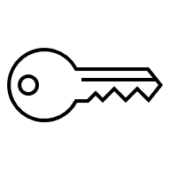


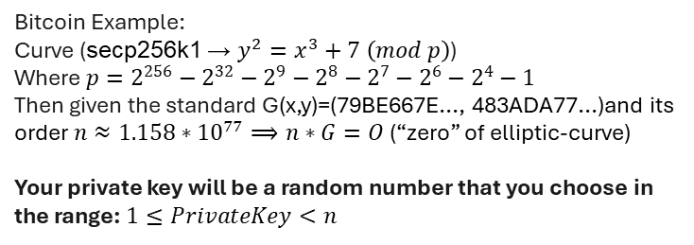
The keys: Private and Public
What proofs that you own your assets
Private Key
Public Key
- A secret string of characters that proves ownership of cryptocurrency.
- A derived string from the private key that can be shared openly.
- Acts as your blockchain address, allowing transactions to be verified without revealing your private key.
- Must be kept secure because anyone with it can access your funds.
- Used by others to send you cryptocurrency.
- Used to sign transactions and unlock your assets.
This is like your mailbox, anyone can send you a letter
If stolen or lost -> Assets will be lost forever!!!
Bitcoin Example:
Curve (secp256k1 → $y^{2}=x^{3}+7 \left(mod p\right)$)
Where $p=2^{256}−2^{32}−2^{9}−2^{8}−2^{7}−2^{6}−2^{4}−1$
Then given the standard G(x,y)=(79BE667E..., 483ADA77...)and its order ${n≈1.158∗10}^{77}⟹n∗G=O$ (“zero” of elliptic-curve)
Your private key will be a random number that you choose in the range: $1≤PrivateKey<n$
To calculate your public you just need to calculate:
$PublicKey=PrivatKey∗G$
Notes:
Presenter Notes:
Invente Román, invente

Slide 15
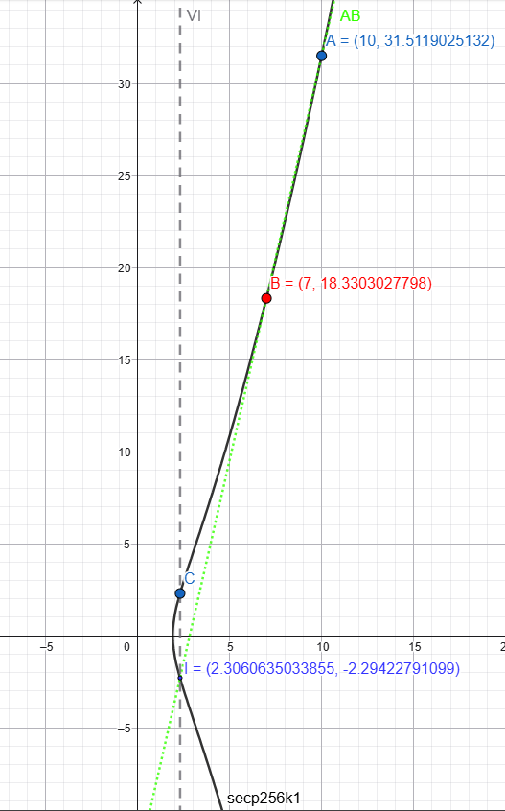
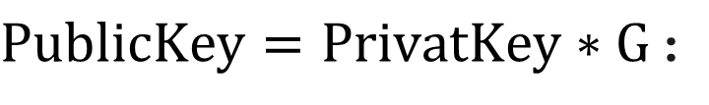
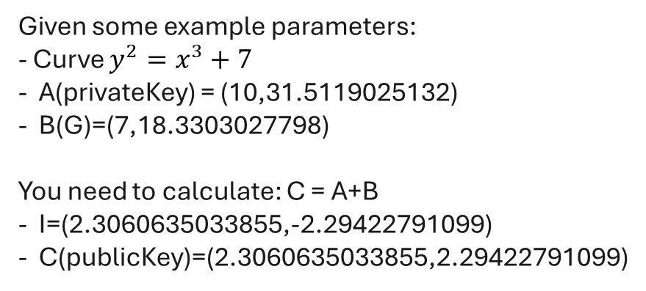
$PublicKey=PrivatKey∗G$:
Given some example parameters:
- Curve $y^{2}=x^{3}+7$
A(privateKey) = (10,31.5119025132)
B(G)=(7,18.3303027798)
You need to calculate: C = A+B
I=(2.3060635033855,-2.29422791099)
C(publicKey)=(2.3060635033855,2.29422791099)
Notes:
Presenter Notes:
Invente Román, invente

Slide 16
Blockchain in the Real World
Practical applications transforming industries
📦
💰
🆔
Supply Chain Transparency
Financial Services
Digital Identity
Track products from origin to consumer with immutable records.
Enable instant settlements and cross-border payments without intermediaries.
Self-sovereign identity controlled by individuals, not institutions.
Verify authenticity and prevent counterfeits
Reduce fraud and improve efficiency
Lower transaction costs
Financial inclusion for unbanked populations
Secure, portable identity credentials
Privacy and control over personal data
🚚
🗳️
🏥
Logistics & Tracking
Voting Systems
Healthcare Records
Real-time tracking of shipments with transparent, verifiable records.
Transparent, tamper-proof voting that's auditable and verifiable.
Secure, interoperable medical records accessible to authorized providers.
Reduce delays and improve transparency
Enable automated payment
Prevent fraud and ensure election integrity
Increase voter participation and trust
Patient control over health data
Improved care coordination and research
16
Notes:
Presenter Notes: "Now, let's look at real-world applications. Blockchain is not just about cryptocurrency. It's a technology that can be applied to many industries. In supply chain management, blockchain enables transparency. You can track a product from the factory to your hands, with immutable records at each step. This prevents counterfeiting and fraud. In finance, blockchain enables instant settlements and cross-border payments without intermediaries. This reduces costs and brings financial services to people who don't have access to traditional banks. In identity, blockchain enables self-sovereign identity, you control your credentials, not a government or corporation. In healthcare, blockchain can secure medical records and give patients control over their data. In voting, blockchain creates tamper-proof voting systems that are transparent and auditable. And in logistics, blockchain provides real-time tracking with transparent records. These are just examples. The underlying principle is the same: blockchain enables trust without intermediaries."

Slide 17
The Challenges: Energy, Regulation, and Scalability
Energy Consumption
Multiple approaches to reduce energy consumption while maintaining security.
Proof of Work requires significant computational power, consuming substantial electricity
- Proof of Stake: Ethereum PoW -> PoS, reducing by 99.95%
Bitcoin alone uses ~150 TWh/year
(comparable to Argentina)
→
- Renewable Energy: Mining powered by renewables
- Layer 2 Solutions: Reduce on-chain transactions
Environmental impact concerns
In Progress …
Regulatory Uncertainty
Governments and industry working toward balanced regulatory frameworks.
Lack of clear legal frameworks creates uncertainty for businesses and users.
- Regulatory Clarity: EU, US frameworks (MiCA law - 2023)
- Inconsistent regulations across jurisdictions
→
- Industry Standards: Best practices emerging for compliance
- Unclear tax treatment and legal status
- Institutional Adoption: Mainstream acceptance increasing
- Risk of restrictive policies
Emerging
Scalability
Multiple scaling solutions at various stages of implementation.
Current blockchains process fewer transactions than traditional systems.
- Layer 2: Lightning Network, Rollups (1000s tx/sec)
- Bitcoin: ~7 transactions/sec (Visa: ~65k/sec)
→
- Sharding: Parallel processing (Ethereum 2.0)
- High fees during network congestion
- New Consensus: New mechanisms improving throughput
- Limits mass adoption for everyday payments
Active Development
Notes:
Presenter Notes:
Invente Román, invente

Slide 18
The Programmable Trust: Four Key Takeaways
Essential concepts that define blockchain technology
1
Decentralized Ledger
Blockchain is a distributed database replicated across many nodes. No single entity controls it. Everyone has a copy, and everyone can verify the data.
2
Cryptographic Security
Blockchain uses cryptography to prove ownership and authenticity. Your private key is mathematical proof that you own your assets. No one can forge this proof.
3
Consensus Mechanisms
Blockchain achieves agreement without intermediaries through consensus mechanisms like Proof of Work or Proof of Stake. The network collectively validates transactions.
4
Transformative Potential
Blockchain can transform industries by enabling trust without intermediaries. From supply chains to finance to identity, the applications are vast and still being discovered.
"Blockchain is not a technology that will replace everything. It's a technology that solves specific problems: creating trust without intermediaries, ensuring transparency, and enabling programmable systems. When applied correctly, it has the power to transform how we organize society."
Notes:
Presenter Notes: "Let me summarize the four key takeaways.
First, blockchain is a decentralized ledger. It's a distributed database replicated across many nodes. No single entity controls it. Everyone has a copy, and everyone can verify the data.
Second, blockchain uses cryptographic security. Your private key is mathematical proof that you own your assets. No one can forge this proof.
Third, blockchain achieves consensus without intermediaries. Through mechanisms like Proof of Work or Proof of Stake, the network collectively validates transactions.
Fouth, blockchain has transformative potential. It can transform industries by enabling trust without intermediaries. From supply chains to finance to identity, the applications are vast.
Now, let me be clear about what blockchain is and isn’t.
- Blockchain is not a technology that will replace everything. It's not a get-rich-quick scheme. It's not anonymous. It's not unregulated.
Blockchain is a technology that solves specific problems: creating trust without intermediaries, ensuring transparency, and enabling programmable systems.
When applied correctly, it has the power to transform how we organize society. The future of blockchain is not about cryptocurrency speculation.
It's about building systems that are transparent, verifiable, and trustworthy.
Systems where trust is embedded in the code, not in institutions. That's the promise of blockchain. That's the programmable trust."

Slide 19
References:
Presentation: Puebla Ruisánchez, Á. (2025, Oct 15). The Programmable Trust: Understanding Blockchain. Wrocław University of Science and Technology.
Slide 1: OpenAI. (2025, November 30). Photo of 2 people in a blockchain [Image generated by ChatGPT]. OpenAI.
Slide 3: Freepik. (n.d.). X-logo vectors [Vector images]. Freepik. https://www.freepik.com/free-photos-vectors/x-logo
Slide 5: Bitcoin.org. (n.d.). Bitcoin Core. https://bitcoin.org/en/bitcoin-core
Slide 5: GeeksforGeeks. (n.d.). Linked list in C. GeeksforGeeks. https://www.geeksforgeeks.org/c/linked-list-in-c/
Notes:
Presenter Notes:
Invente Román, invente

Slide 20
Bibliography:
Dot CSV: https://youtu.be/V9Kr2SujqHw?si=TjAIiOdzJ0Vcv7RT
Nakamoto, S. (2008). Bitcoin: A Peer-to-Peer Electronic Cash System. https://bitcoin.org/bitcoin.pdf
Certicom Corp. (2010). SEC 2: Recommended Elliptic Curve Domain Parameters. https://www.secg.org/sec2-v2.pdf
Narayanan, A., Bonneau, J., Felten, E., Miller, A., & Goldfeder, S. (2016). Bitcoin and Cryptocurrency Technologies: A Comprehensive Introduction. Princeton University Press.
Dwork, C., & Naor, M. (1992). Pricing via Processing or Combatting Junk Mail (proof-of-work origins). Proceedings of CRYPTO ’92.
Bonneau, J., Miller, A., Clark, J., Narayanan, A., Kroll, J. A., & Felten, E. (2015). SoK: Research Perspectives and Challenges for Bitcoin and Cryptocurrencies. IEEE Symposium on Security and Privacy
Notes:
Presenter Notes:
Invente Román, invente

Slide 21
Thanks for your time
Questions?
Notes:
Presenter Notes:
Invente Román, invente

